Slide 1

SMART MEDICINE REMINDER AND VENDING MACHINE
FIRST INDIVIUAL MEETING: SCHEMATIC DESIGN
INSTRUCTOR: Prof. Mike Aleshams
Student Name: Nishitha Kodur
Student ID: C0771813

Slide 2
INTRODUCTION
To overcome the problem of forgetting to take medicines in elderly people, we came up with a 'SMART MEDICINE REMINDER AND VENDING MACHINE.
' It is an IoT device which reminds and dispenses medicine on time.
In this project , we design and develop a medicine reminder and vending machine using Amazon Alexa and Raspberry pi.
The machine saves dispense and alarm time, when it is time to dispense the medicine, the machine alarms the user and dispenses the medicine to the racks.

Slide 3
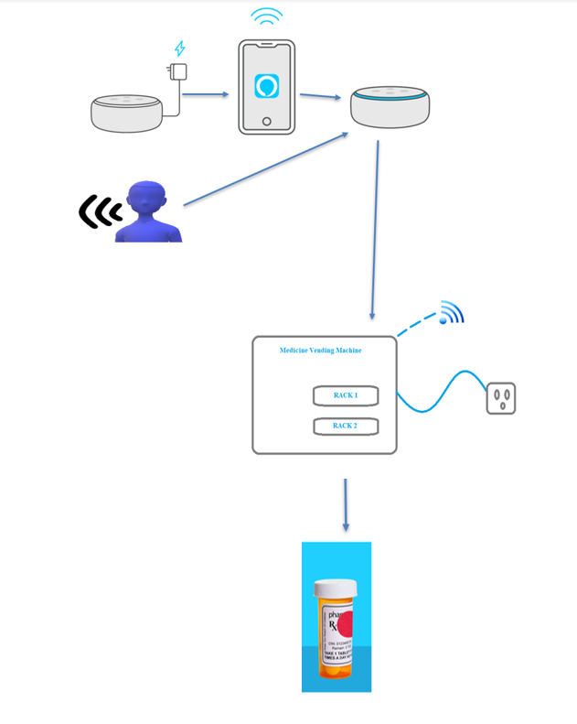
ENGINEERING DESIGN

Slide 4
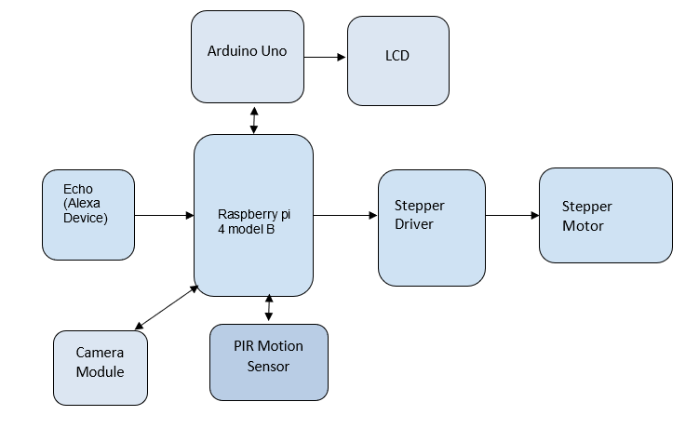
BLOCK DIAGRAM

Slide 5
INTRODUCTION TO A SCHEMATIC DIAGRAM
A schematic is defined as a picture that shows something in a simple way, using symbols.
It is a picture that represents the components of a process, device, or other object using abstract, often standardized symbols and lines.
Schematic diagrams only depict the significant components of a system, though some details in the diagram may also be exaggerated or introduced to facilitate the understanding of the system.

Slide 6
INTRODUCTION TO A SCHEMATIC DIAGRAM
Schematic diagrams do not include details that are not necessary for comprehending the information that the diagram was intended to convey.
For example, in a schematic diagram depicting an electrical circuit, we can see how the wires and components are connected together, but not photographs of the circuit itself.

Slide 7
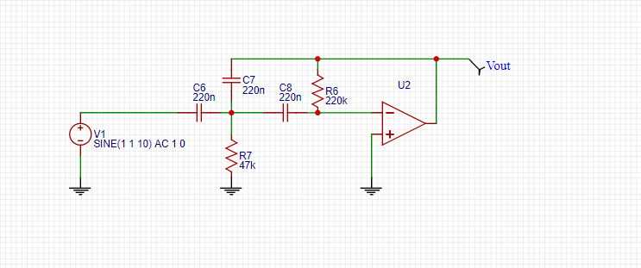
EXAMPLE OF A SCHEMATIC DIAGRAM
Highpass filter 7Hz

Slide 8
IMPORTANCE OF SCHEMATIC DIAGRAM IN A PROJECT
Schematic diagrams are typically associated with electrical circuits. Also called wiring diagrams or circuit diagrams, these diagrams show how the different components of a circuit are connected.
In these diagrams, lines represent connecting wires, while other elements like resistors, lamps, and switches are represented by standardized symbols called electrical schematic symbols.

Slide 9
IMPORTANCE OF SCHEMATIC DIAGRAM IN A PROJECT
In electronics, having a schematic diagram on hand may help a user design an entire circuit before building it, or troubleshoot an electronic that has stopped working.
Schematic diagrams may also be used to explain the general way that an electronic functions without detailing the hardware or software used in the actual electronic.
For example, to explain how a computer projects the words you type on a screen, you might use a schematic diagram that shows how information passes from the keys you press to a word processing program, and finally to the computer screen.

Slide 10
POPULAR (Open-Source) SOFTWARES AVAILABLE FOR SCHEMATIC DESGIN
Autodesk Eagle
KiCAD
Fritzing
DesignSpark PCB
EasyEDA

Slide 11
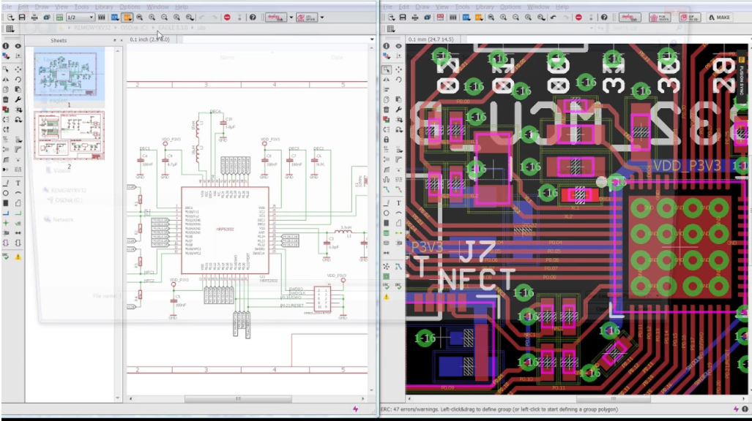
POPULAR (Open-Source) SOFTWARES AVAILABLE FOR SCHEMATIC DESGIN
Autodesk Eagle:
Eagle is one of the most well known schematics and PCB Design software.
Autodesk EAGLE contains a schematic editor, for designing circuit diagrams and a PCB layout editor for designing PCBs. It provides component placement, PCB routing, a comprehensive library content, a thriving community, and many more.
EAGLE is now only available with a Fusion 360 subscription. It includes 2 schematic sheets, 2 signal layers, and an 80cm² board area.
Eagle is available for Windows, Linux, and Mac.

Slide 12
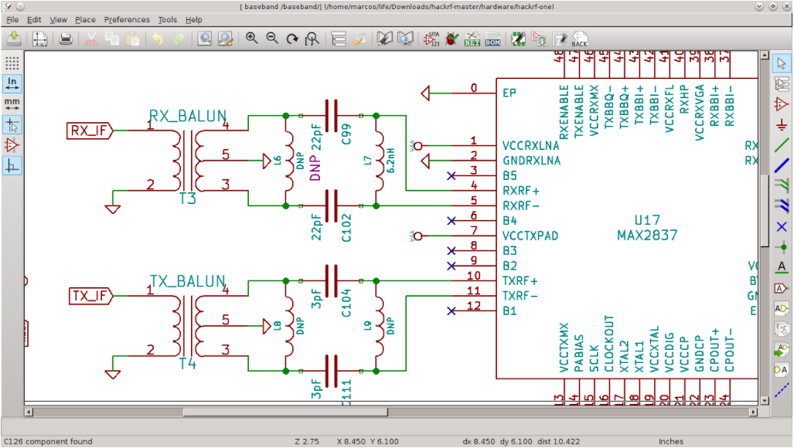
POPULAR (Open-Source) SOFTWARES AVAILABLE FOR SCHEMATIC DESGIN
KiCAD:
KiCAD is a Cross-Platform and Open Source Electronics Design Automation Suite.
It includes a schematic editor for creating and editing schematic designs, a PCB Editor for making professional PCB layouts with up to 32 copper layers, and a 3D viewer which can be used to inspect the design in a 3D form.
Unlike Eagle, KiCAD is entirely free, and no paywall is needed to use some of its features.
KiCAD is available on Windows, Linux, and Mac.

Slide 13
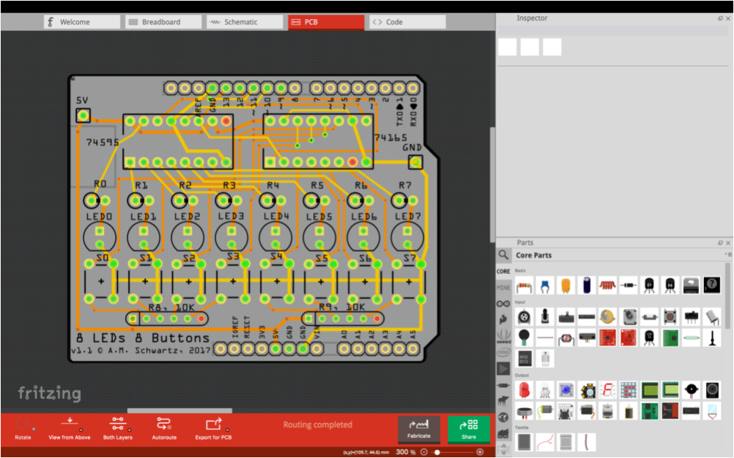
POPULAR (Open-Source) SOFTWARES AVAILABLE FOR SCHEMATIC DESGIN
Fritzing:
Fritzing is an open-source platform for learning electronics.
Fritzing became popular with its examples of Arduino and its an easy to use platform. Fritzing includes a breadboard layout, schematic, and PCB view for designing a PCB layout for our board.
The software is available for Windows, Linux, and Mac.

Slide 14
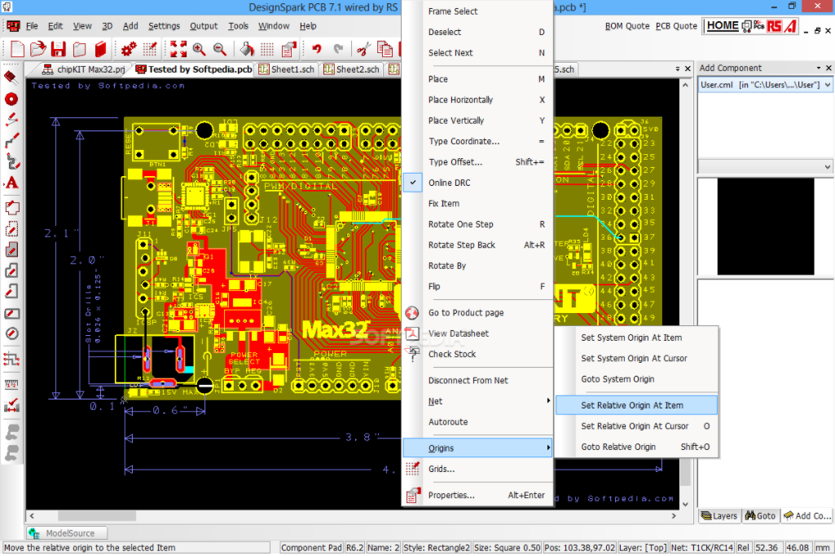
POPULAR (Open-Source) SOFTWARES AVAILABLE FOR SCHEMATIC DESGIN
DesignSpark PCB:
Easy-to-learn environment, with a schematics capture and PCB layout tool, DesignSpark PCB is one of the EDA tools to try out.
It is free, comes with an excellent schematic capture, PCB editor for designing an unlimited number of PCB layers, a part and library creator, 3D views, and many more features.
DesignSpark PCB is only available for Windows.

Slide 15
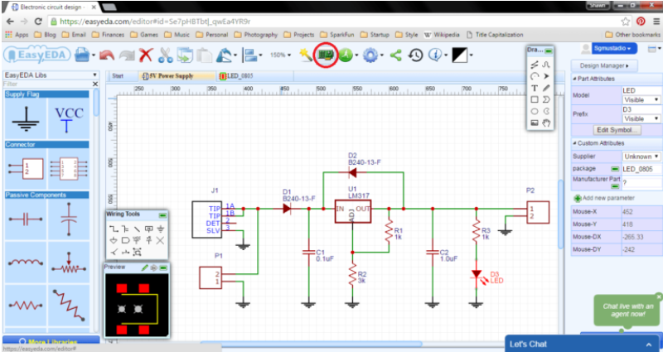
POPULAR (Open-Source) SOFTWARES AVAILABLE FOR SCHEMATIC DESGIN
EasyEDA is a free and a paid EDA tool.
EasyEDA provides a powerful schematic capture, PCB editor, Libraries designer, a project management tool, and lastly a team collaborator.
EasyEDA also has an integration with LCSC.com component catalog for providing real-time stocks and pricing information about components used.
EasyEDA is online based and also desktop based.
It is cross-platform and supports Windows, Linux, and Mac.
For designing schematic of our project we chose EASY EDA software based on the above features provided by it.

Slide 16
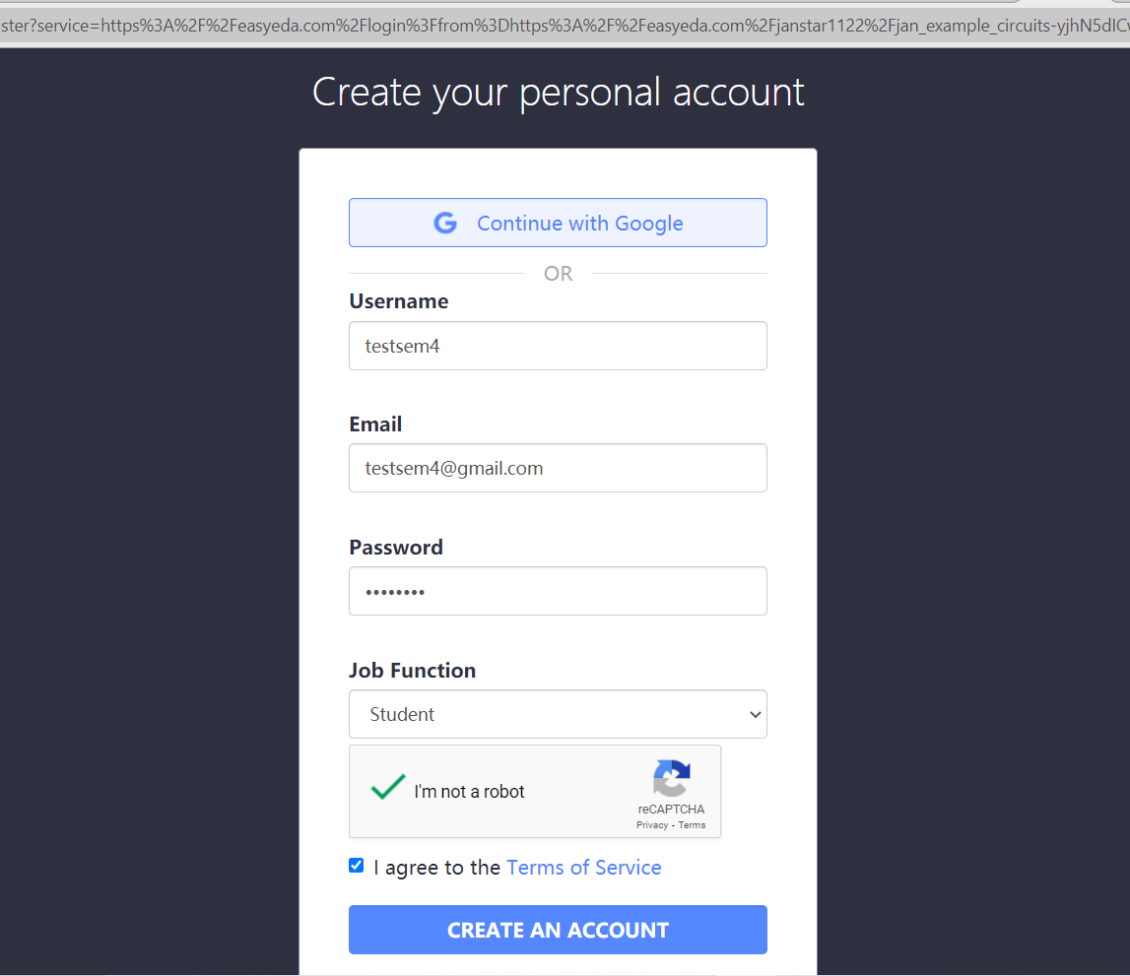
STEPS TO REGISTER
Go to the URL https://passport.easyeda.com/register and register by creating an account.

Slide 17
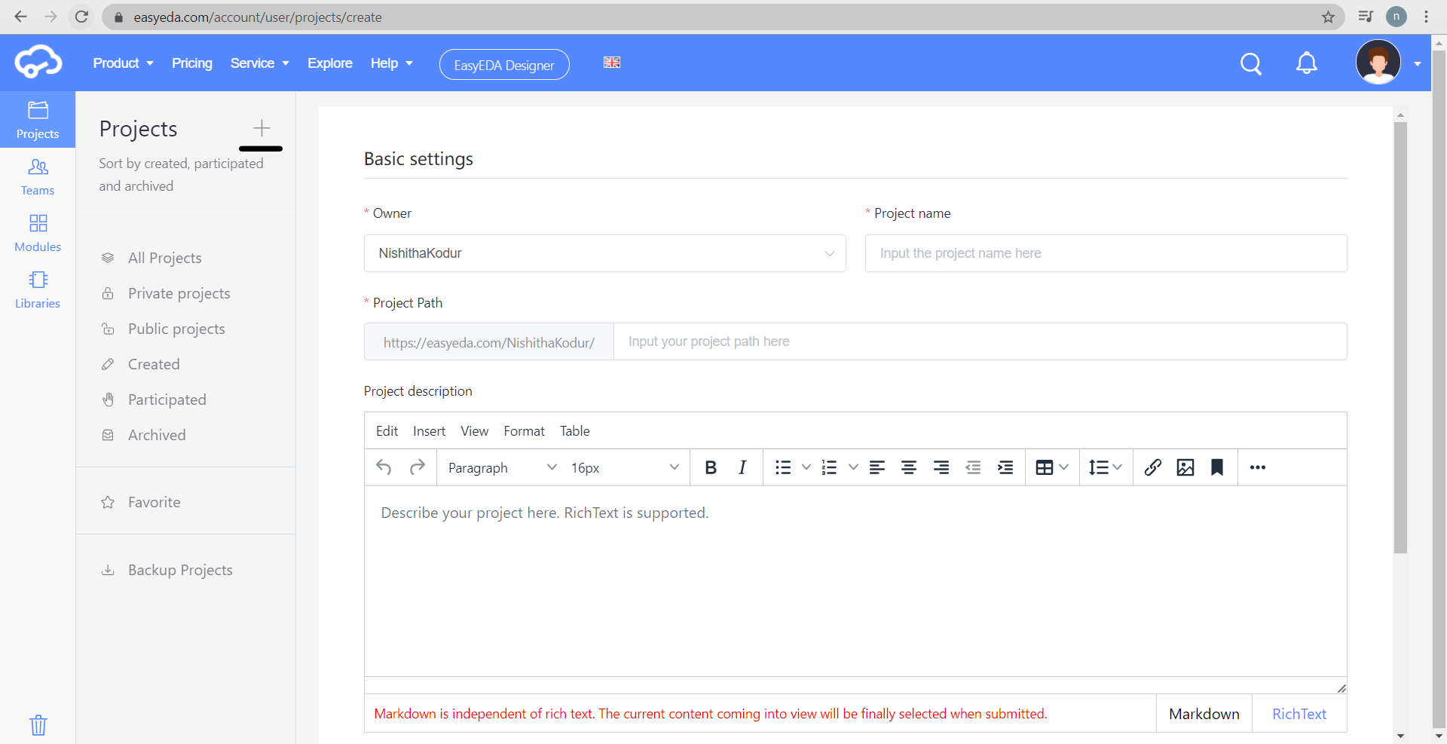
GETTING STARTED WITH EASY EDA
Once the account is created, we can start designing the schematic.
As this is online, we can retrieve our schematic on any other PC by logging into the registered account.
We can start designing the schematic right away by following the below steps.
Click on the + icon to create a new project.

Slide 18
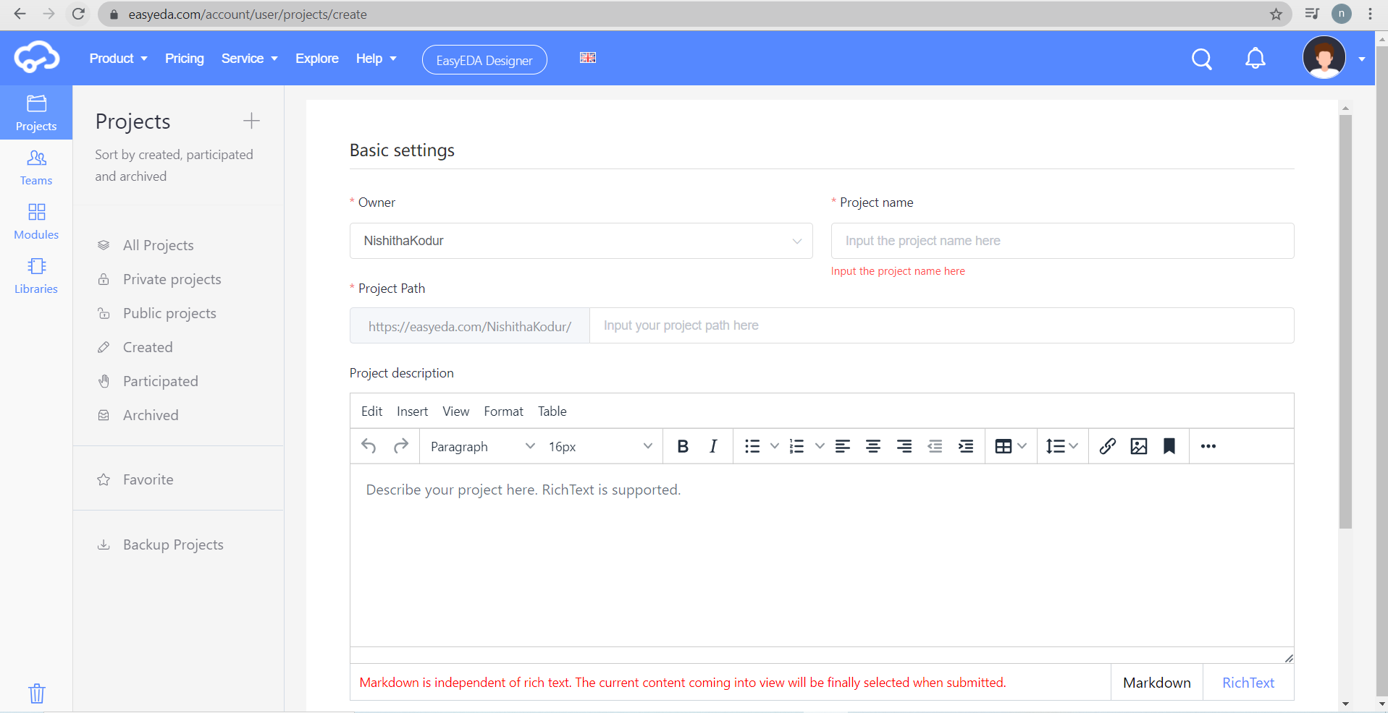
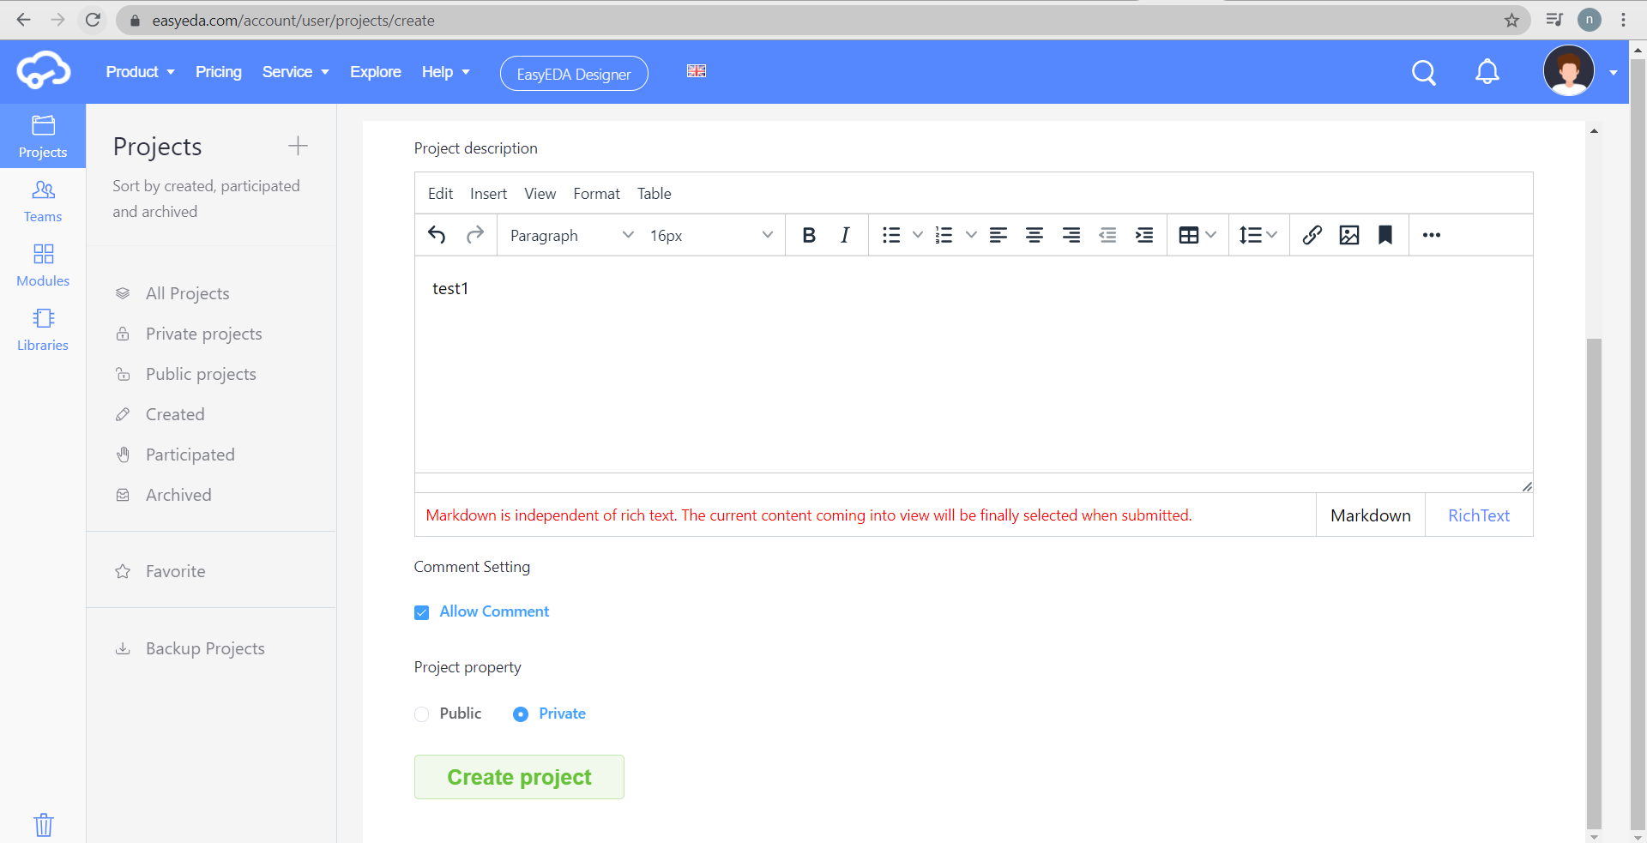
CREATING A PROJECT
2. Enter the details of the project in the below screen.
3. Click Create Project.

Slide 19
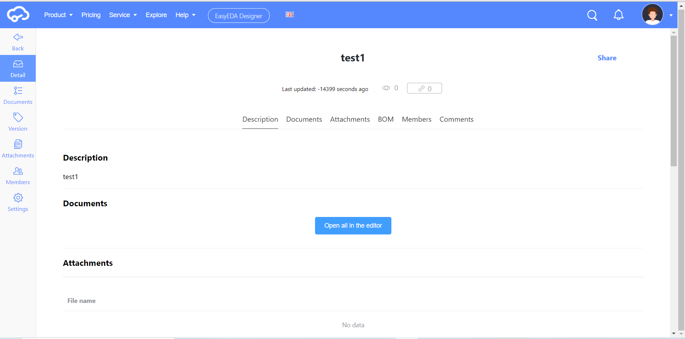
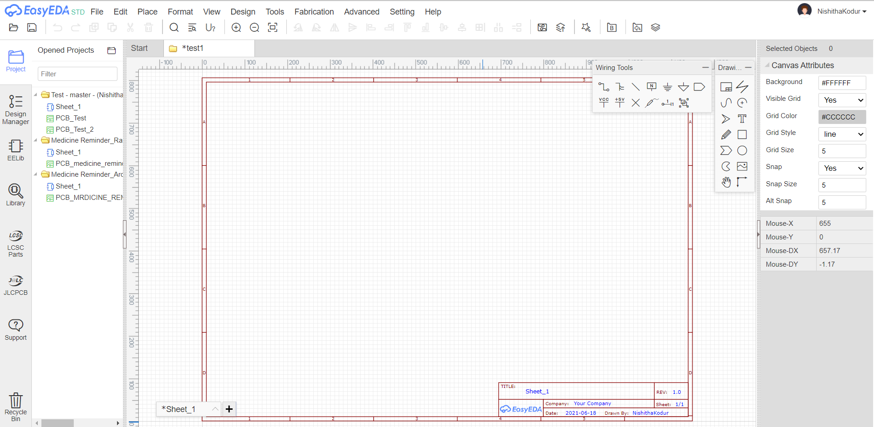
CREATING A PROJECT
4. Below screen is displayed after clicking ‘Create Project’.
5. Click the button ‘Open all in the editor’.
6. Schematic design sheet opens up for the created project.

Slide 20
STEPS FOR COMPLETING A SCHEMATIC AND PCB DESIGN
There are three main steps in designing a schematic and converting it to PCB:
Design the schematic (circuit)
Making tracks
Checking errors (DRC in PCB)

Slide 21
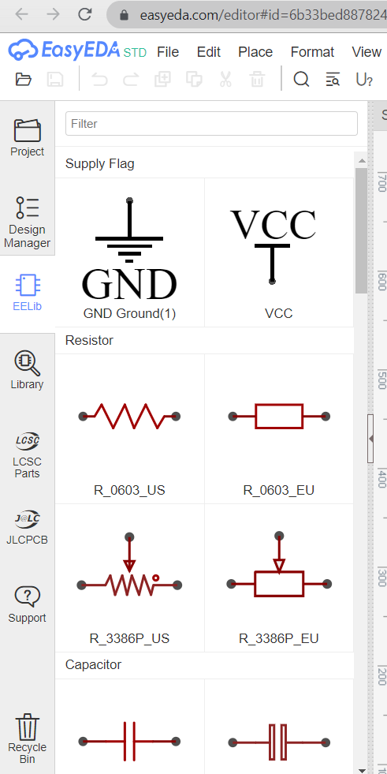
DESIGNIGN A SCHEMATIC
Once we are in the schematic design screen, we have options to place components and connect them with the libraries and tools provided.
Using EELib:
Contains ready made symbols for a wide range of components which can be simulated.

Slide 22
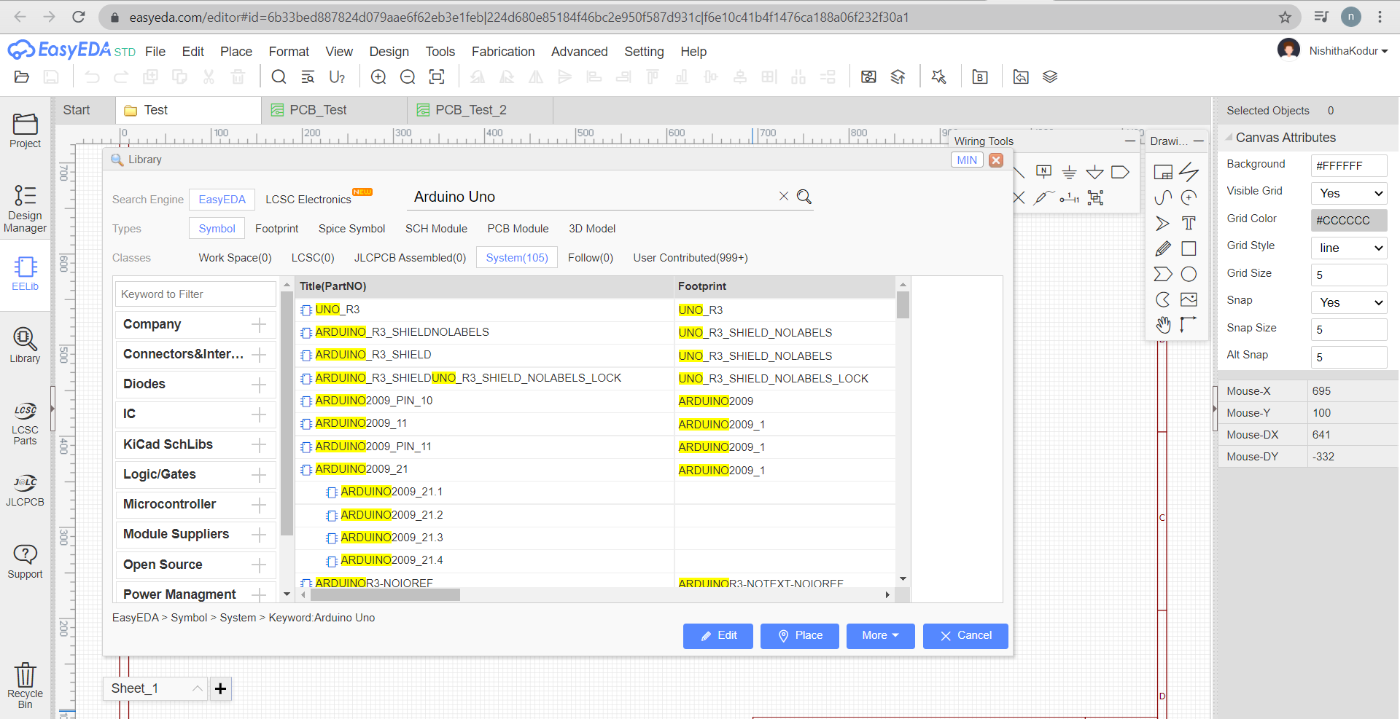
DESIGNIGN A SCHEMATIC
3. Library:
EasyEDA provide a lot of libraries, we can find them at “Left-hand Panel - Library”, hotkey “SHIFT+F”, at here we can search library from LCSC, system, user contributed etc.

Slide 23
DESIGNIGN A SCHEMATIC
Type
Symbol: Schematic symbols
Spice Symbol: Symbols for spice simlation
Footprint: PCB footprints, PCB pattern.
SCH Modules: Schematic modules, a part of the circuit design. It can not assign the PCB module, doesnt like the schematic Symbol can assign the footprint . when it be placed on the schematic, it will be separated.
PCB Modules: As like as Schematic modules.
3D Model: It is bind with footprint via “3D Model Manager”.

Slide 24
DESIGNIGN A SCHEMATIC
Classes
Work Space: It include your personal parts and your teams’ parts.
LCSC: EasyEDA online part store LCSC.com parts(Officail Parts). It will add new libraries everyday
LCSC Assembled: JLCPCB Assembled parts. All JLCPCB assembly parts will contain a SMT icon, that means this part can be JLCPCB assemble.
System: EasyEDA system parts, it comes from open source libraries, such as Kicad libraries, company public libraries, user contributions.
Follow: If we follow a user at EasyEDA(we can follow a user at him/her user page), we can view and use his/her libraries.
User Contributed: When searching a part, maybe we can find it at this class. At EasyEDA, all libraries are public. this detail can be refered at: Contribute
We add an “JLCPCB Assembled” Components option of the Parts, It’s easy to choose which component can be assembled by JLCPCB.

Slide 25
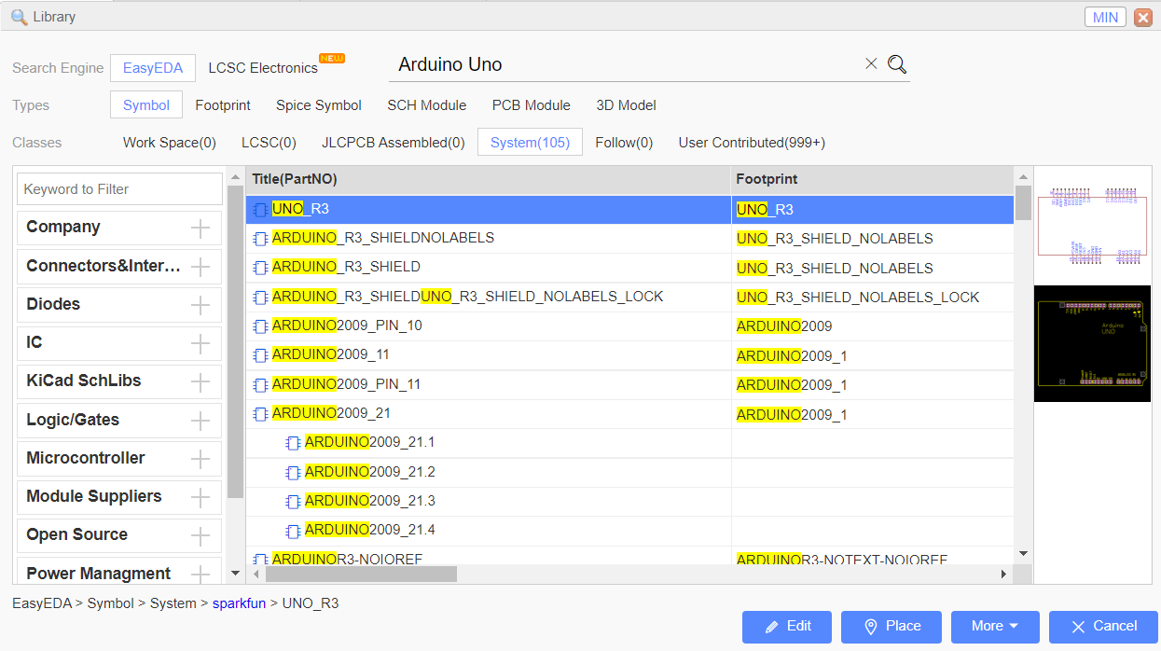
DESIGNIGN A SCHEMATIC
Search Engine - EasyEDA
Simply type part number or symbol’s name to Search.
And then click the “Table of contents” to open the categories list to choose the components.
After finding the required component we can directly preview the component and place on the schematic design sheet.
Make sure to select a component with footprints. Without component footprints, we cannot design a PCB.

Slide 26
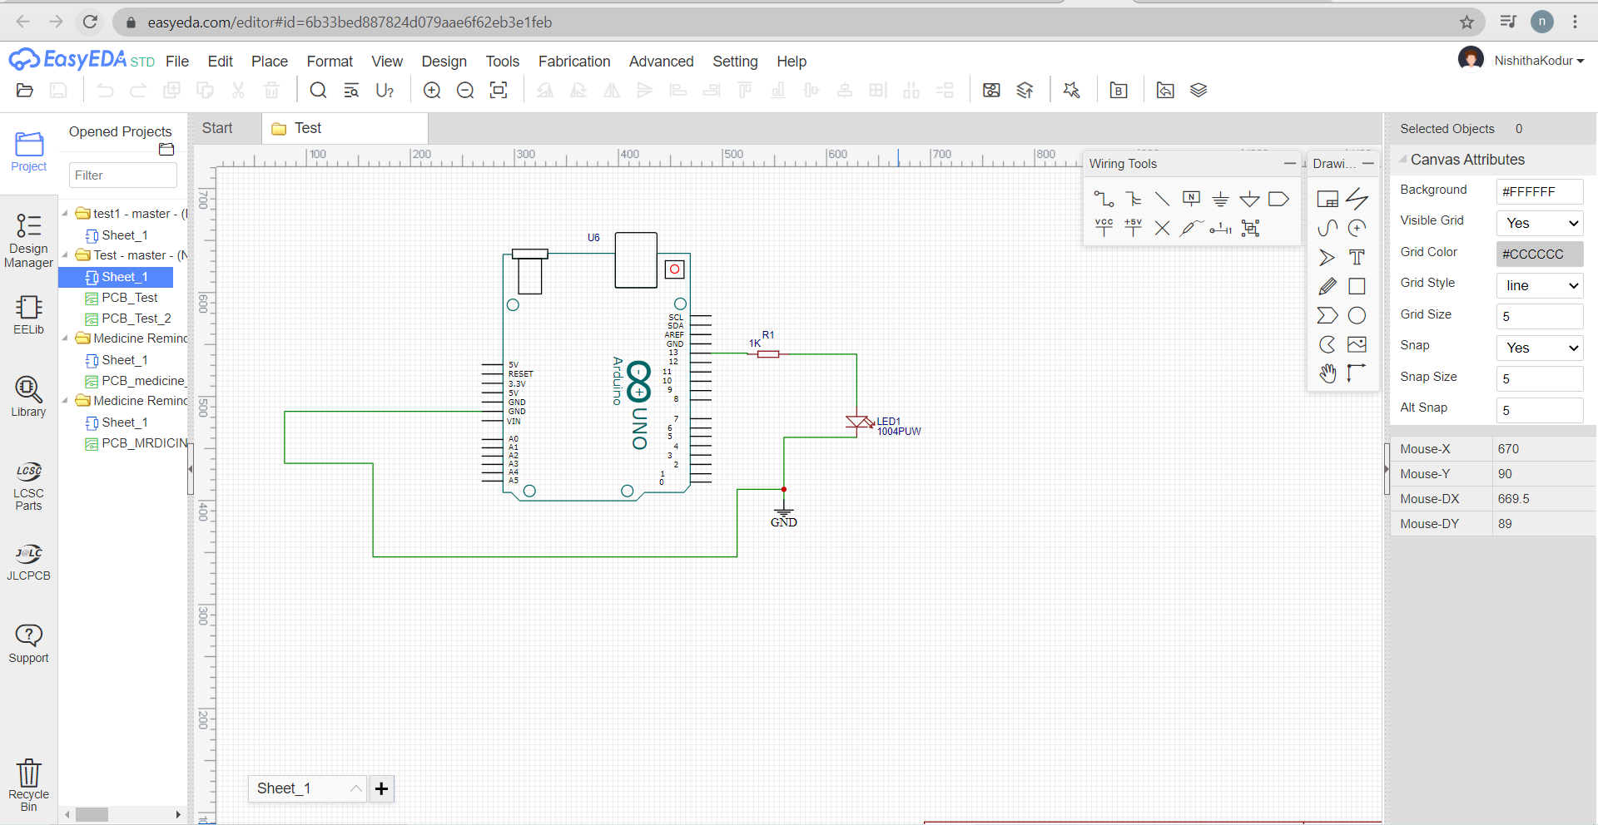
DESIGNIGN A SCHEMATIC
Designing a simple circuit:
Here, I have selected Arduino Uno, 1Kohm, LED and ground.
Using wiring tools, connect all the components.
Make sure to place ground for the circuit.
Click Ctrl+S to save the schematic.

Slide 27
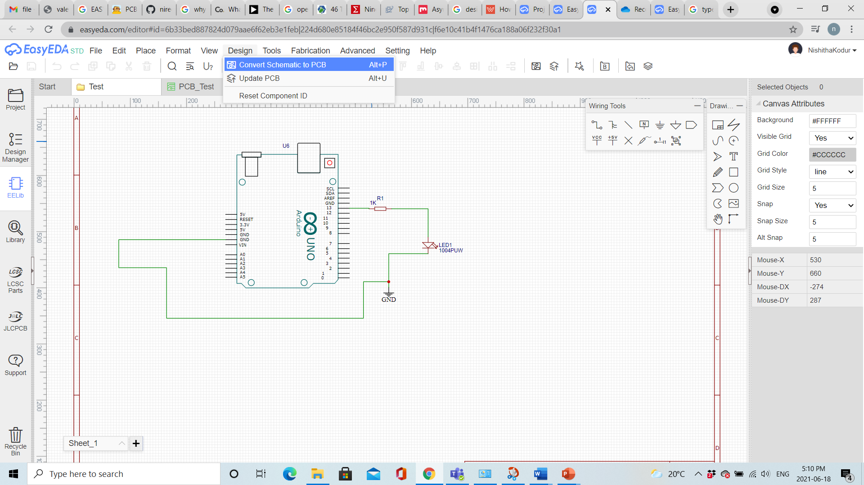
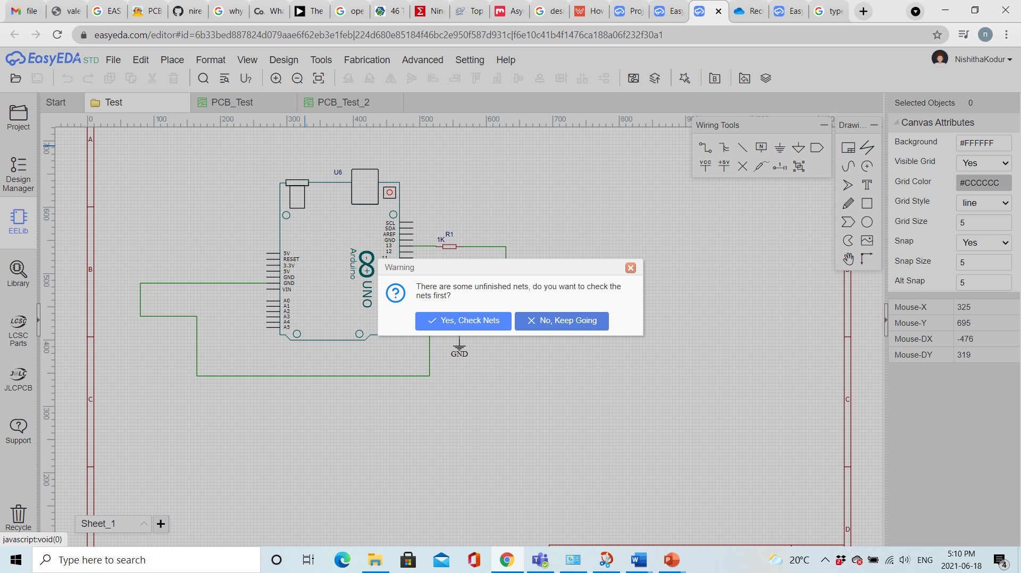
DESIGNIGN A SCHEMATIC
Click Design from the Menu bar. Select ‘Convert to PCB’ schematic’ option.
Click ‘No, Keep going’ from the pop-up window.

Slide 28
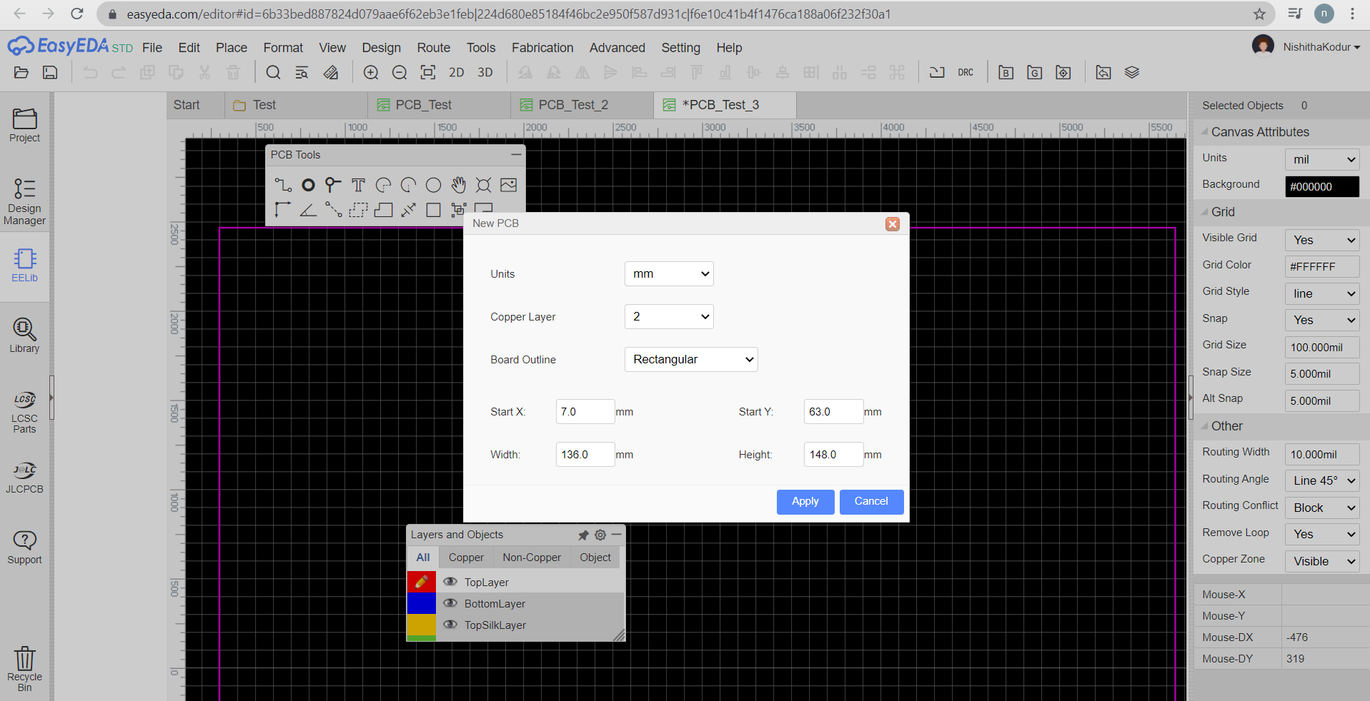
DESIGNING PCB
Click Apply in the below window. This is the dimensions required for the PCB board. We can either select the default dimensions or we can give our required dimensions.

Slide 29
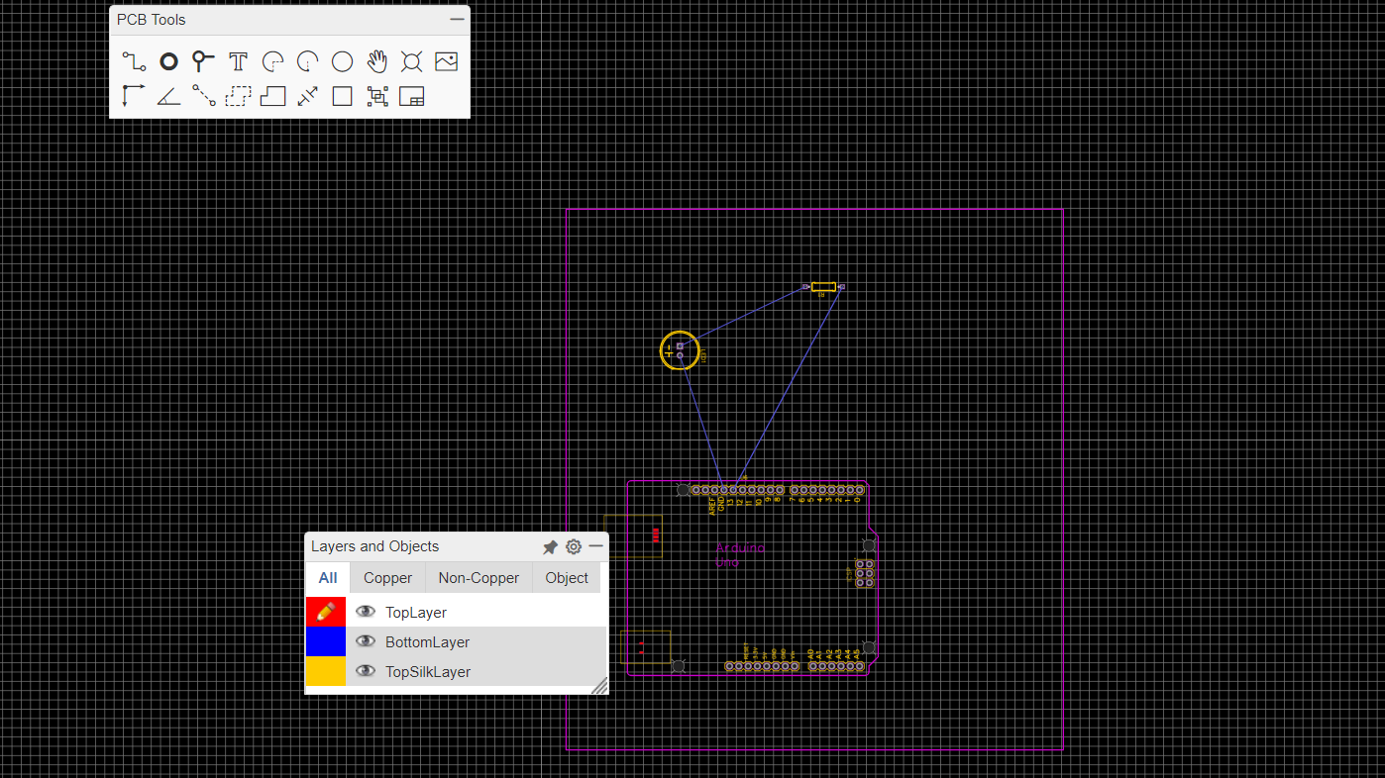
DESIGNING PCB
Drag and place the components in the purple square. To adjust the components if twisted, use the Rotate Right or Rotate left options available on the menu bar by clicking on the component.

Slide 30
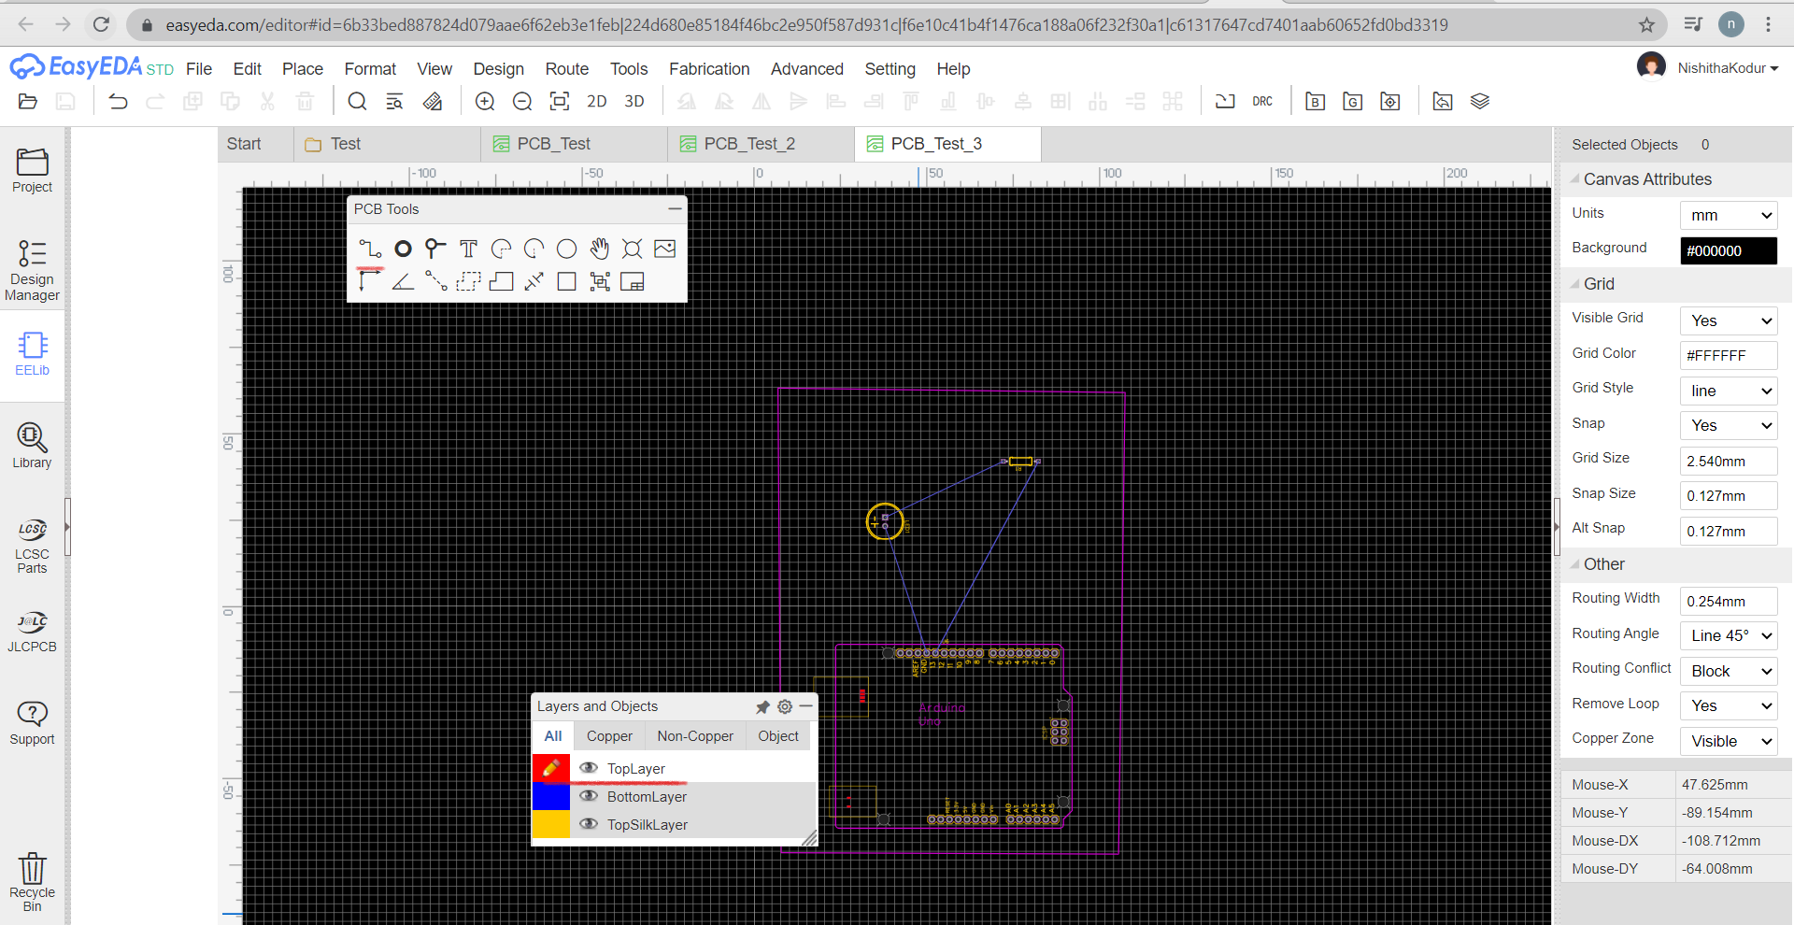
DESIGNING PCB
Connect the components by drawing the tracks using wither bottom layer or top layer. For this particular circuit, I have bottom layer for ground connection and top layer for the rest of the connections on the board.
Select ‘Top Layer’ in Layers and Objects window, Select Track in PCB Tools window.

Slide 31
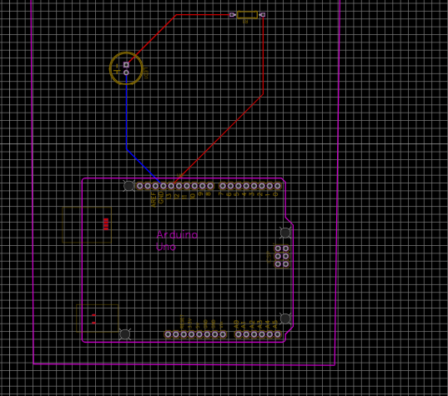
DESIGNING PCB

Slide 32
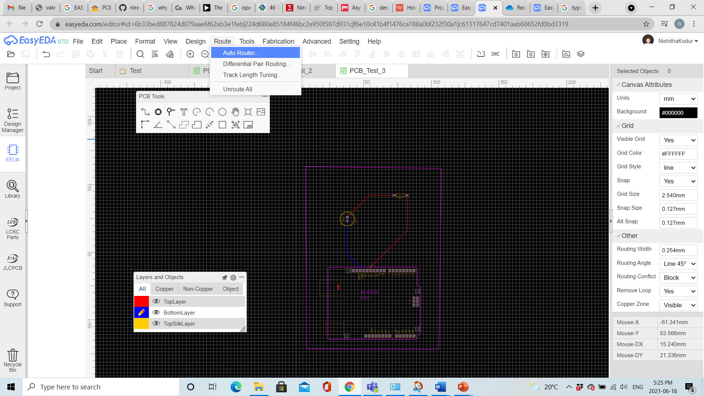
DESIGNING PCB
We also have an option of Auto Route, on selection, components are connected using tracks automatically if there are no errors.

Slide 33
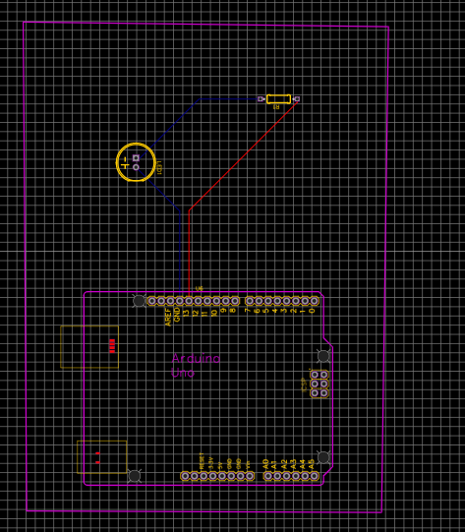
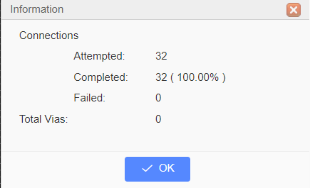
DESIGNING PCB
Once the routing is completed, we get a pop up with the below information. Also the circuit with Auto routed tracks.

Slide 34
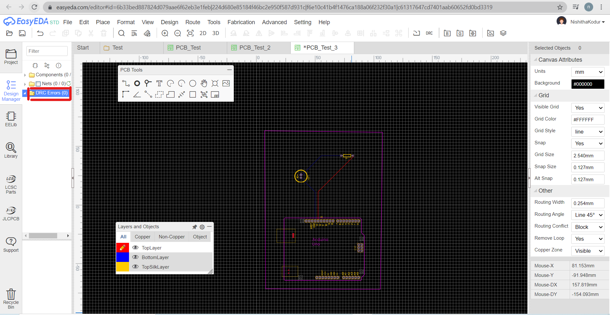
DESIGNING PCB
Once routing is done, we have to check DRC to avoid errors before PCB fabrication.
Go to Design→ Select Check DRC
DRC Errors should be 0 which means there are no errors in the routing done.

Slide 35
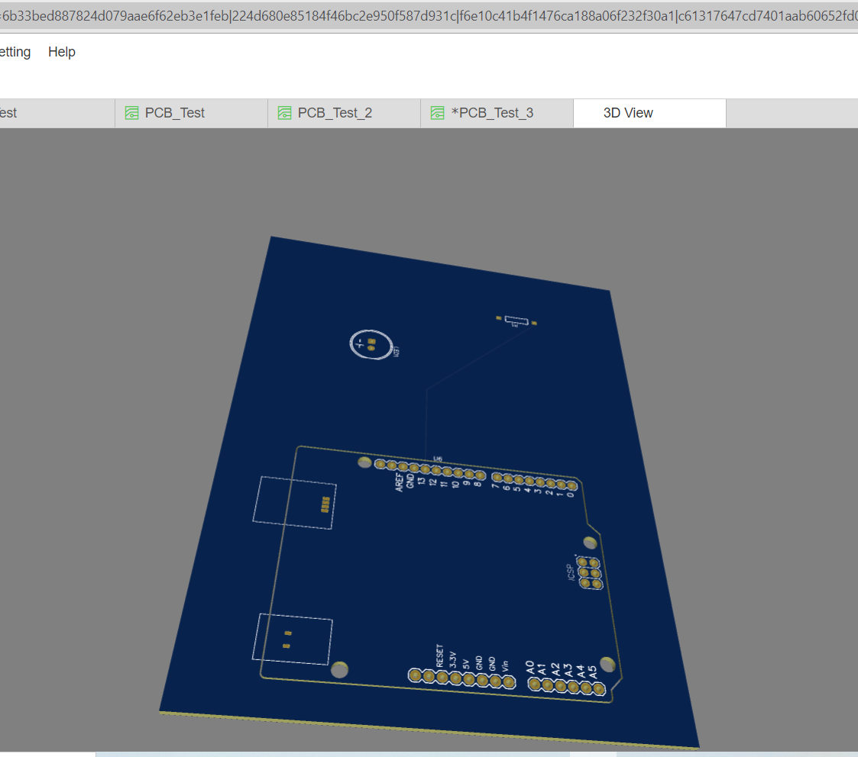
3DVIEW OF THE PCB DESIGN
Click 3D to view the three dimensional view of the PCB.

Slide 36
SCHEMATIC DESIGN FOR THE PROJECT
We have divided the schematic design into two parts
Arduino and LCD
Raspberry pi, Stepper drivers, Stepper motors and PIR motion sensor
These two boards can be connected together using the USB ports of Arduino Uno and Raspberry pi.
Alexa device can be connected to raspberry pi wirelessly. And, raspberry pi camera can be placed directly into the camera module, which does not require any soldering.

Slide 37
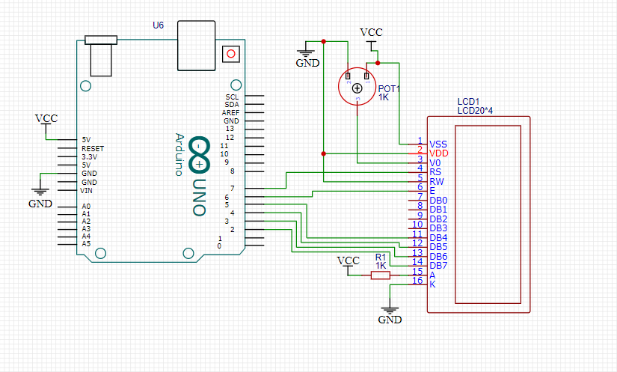
SCHEMATIC DESIGN PART-1
Here, LCD screen is connected to Arduino. Also, a potentiometer is placed to adjust the level of brightness of the LCD.

Slide 38
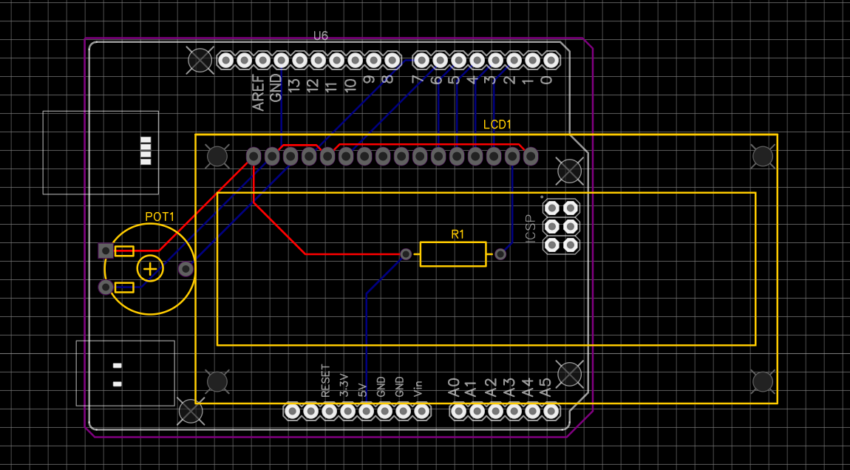
PCB DESIGN PART-1

Slide 39
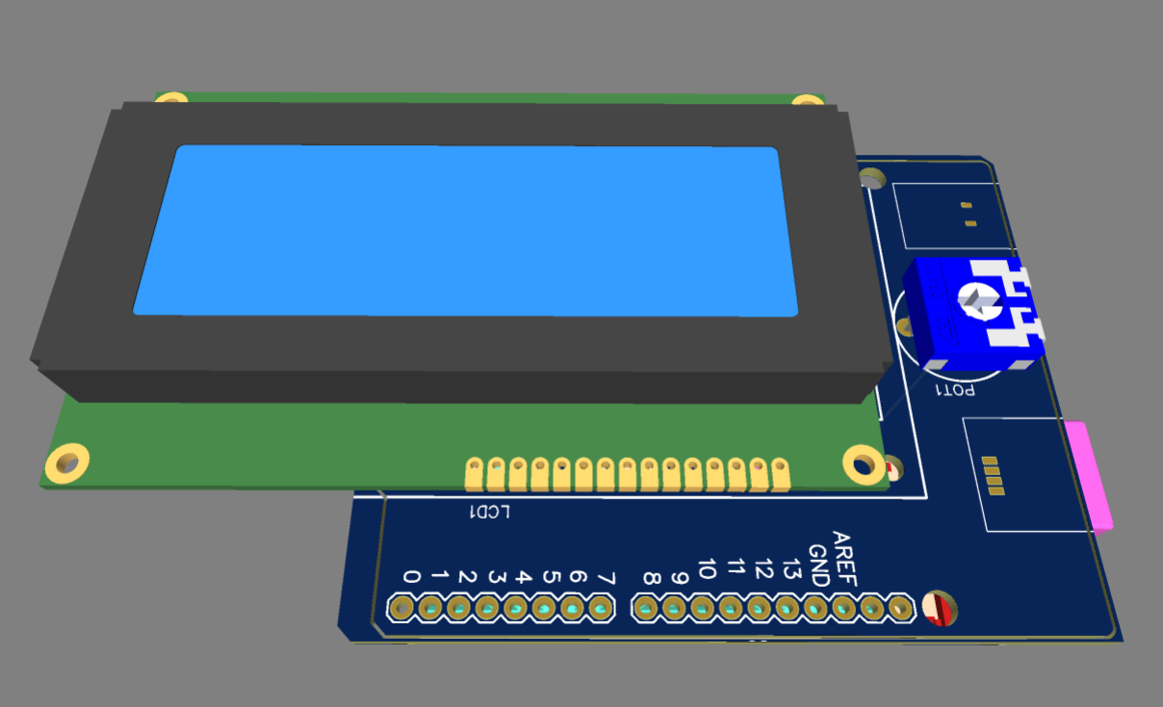
3D DESIGN PART-1

Slide 40
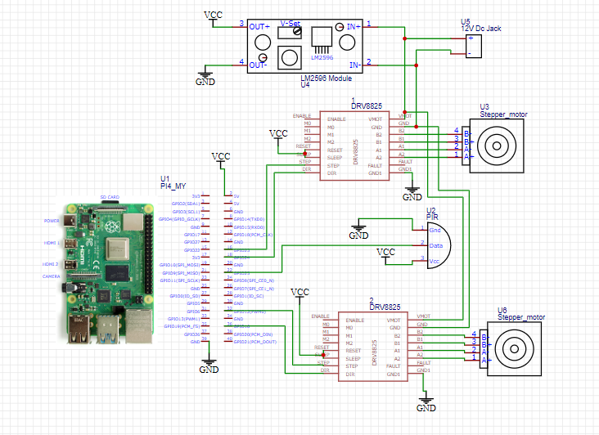
SCHEMATIC DESIGN PART-2
GPIO pins of raspberry pi are connected to stepper drivers. Also, we are connecting LM2596 voltage regulator to step down to regulate the voltage to 5v . As, stepper motor needs 12V and raspberry pi needs only 5V, we are stepping down the voltage to 5v using this voltage regulator to provide 5V Vcc to raspberry pi.

Slide 41
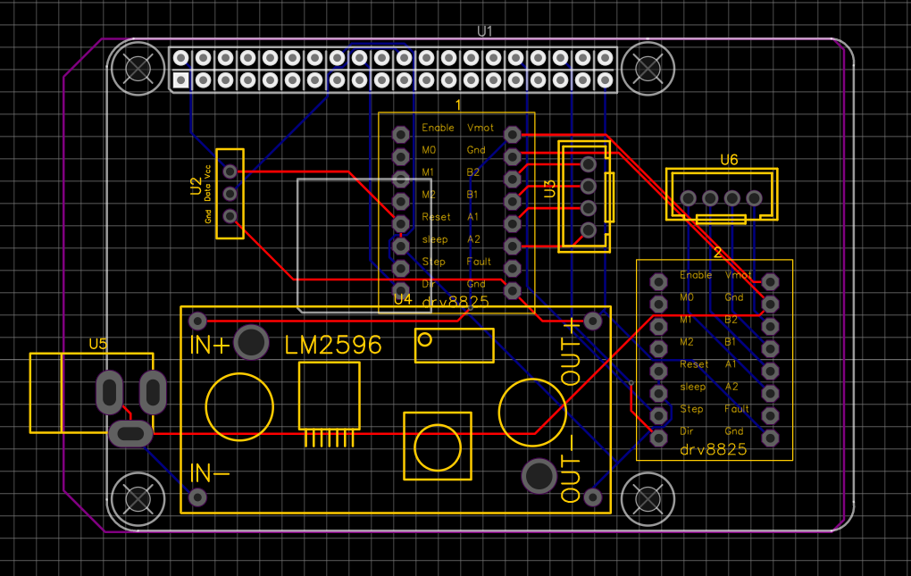
PCB DESIGN PART-2

Slide 42
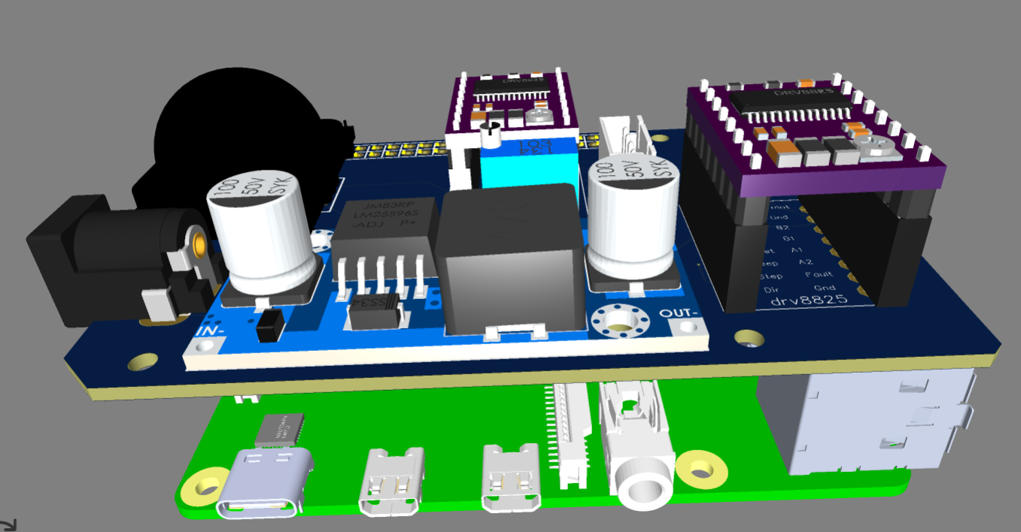
3D DESIGN PART-2

Slide 43
REFERECNCES
Ayibiowu, A. (2019, 09 13). TOP 10 FREE PCB DESIGN SOFTWARE FOR 2019.
Retrieved from Electronics-lab.com: https://www.electronics-lab.com/top-10-free-pcb-design-software-2019/
Easyeda. (n.d.). Libraries.
Retrieved from EASYEDA: https://docs.easyeda.com/en/Schematic/Libraries/index.html
Fahad, E. (2020, October 18). Selecting a Power Supply for Raspberry Pi.
Retrieved from Electronic Clinic: https://www.electroniclinic.com/selecting-a-power-supply-for-raspberry-pi/
Hommer. (n.d.). How to Use EasyEDA to design PCB Schematic Step By Step.
Retrieved from WELLPCB: https://www.wellpcb.com/easyeda.html
Janstar. (2015). JanExampleCircuits.
Retrieved from EASYEDA: https://easyeda.com/janstar1122/jan_example_circuits-yjhN5dICw
Lim, A. (2019, January 29). What is a Schematic Diagram?
Retrieved from ThoughtCo.: https://www.thoughtco.com/what-is-a-schematic-diagram-4584811
Siva. (n.d.). PCB Designing using EasyEDA.
Retrieved from Instructables Circuits: https://www.instructables.com/PCB-Designing-Using-EasyEDA/

Slide 44
THANK YOU

